Slide 1

Department of Information Technology
A.P. Shah Institute of Technology
G.B.Road, Kasarvadavli, Thane(W), Mumbai-400615
UNIVERSITY OF MUMBAI
Academic Year 2019-2020

Slide 2
Real Time Traffic Management using ML Group Members: Jyoti Tiwari
Ankita Deshmukh
Gayatri Godepure
Under the Guidance of
Dr. Uttam Kolekar

Slide 3
1.Project Conception and Initiation

Slide 4
1.1 Abstract
The traffic congestion is the major problem that is faced by individuals.
Our aim is to develop a dummy that reflects todays traffic situation and perform real time signal processing on the dummy model.
Hence we aim to redesign the traffic signal, that is from static switching to signal which performs switching on real-time scenario basis.
The switching time in real time scenario for signals will be decided the density of vehicles on the road.

Slide 5
1.2 Objectives
To design an automated traffic-light control system.
To provide the sophisticated control and coordination on traffic.
To solve the socially arising problem of traffic congestion.
Ability to recognize the current condition of traffic.
Reduce congestion within and between cities.

Slide 6
1.3 Literature Review
Paper Title: Vehicle Detection and Tracking using Gaussian Mixture Model and Kalman Filter.
Authors: Indrabayu, Rizki Yusliana Bakti , Intan Sari Areni, A. Ais Prayogi
Publication details: Electrical Engineering Study Program, Hasanuddin University Makassar, Indonesia
Findings: Gaussian Mixture Model, Kalman Filter
Advantages: GMM for detection of object and Kalman filter for tracking objects.
Disadvantages: Unable to differentiate between two close vehicles.

Slide 7
Literature Review
Paper Title: Vehicle Detection, Tracking and Counting
Authors: Abdul Jalil, Ahmad Ali, Javed Ahmad.
Publication details: Department of Electrical and Electronics Engineering, International Islamic University, Islamabad, Pakistan
Findings: Gaussian mixture model, Kalman filter, Blob, Hungarian Algorithm
Advantages: Hungarian algorithm is a cost estimation model
Disadvantages: The result of detection is not used effectively i.e. No real time predictions are made.

Slide 8
Literature Review
Paper Title: A Real-Time Traffic Detection Method Based on Improved Kalman Filter
Authors: Li Xun, Nan Kaikai, Liu Yao, Zuo Tao.
Publication details: College of Electric and Information, Xi’an Polytechnical University Xi’an, P. R. China.
Findings: Gaussian mixture model, Extended Kalman filter, Heuristic calculation
Advantages: Real-Time Detection of Traffic Based on Target Chain
Disadvantages: Cannot handle signal switching for complex signals.

Slide 9
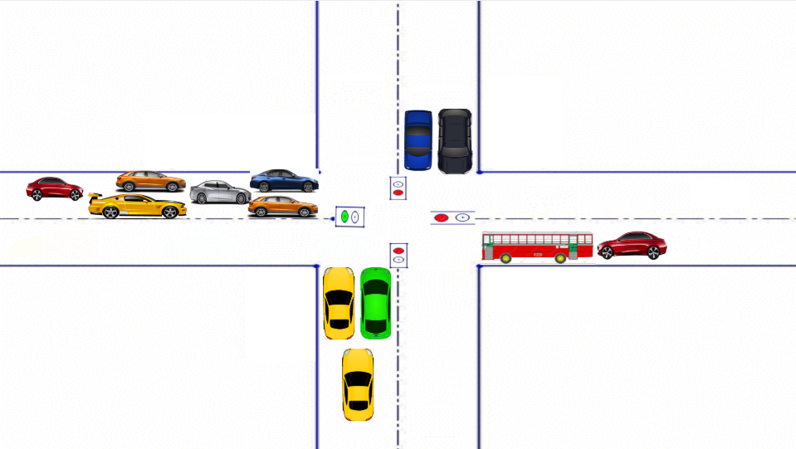
1.4 Problem Definition
To design a model which learns from the surrounding and makes prediction, on the basis of prediction the signal switching will be done so as to ensure minimal vehicular congestion on the road.
The above figure shows heavily populated lane at only one side of road.

Slide 10
1.5 Scope
The project aims to monitor signal and makes decisions taking real time traffic scenario into consideration, thus signal switching will be done in a smart and efficient way.
Traffic Congestion problems at various places will decrease.
Automatic traffic controlling without human intervention.
Improve safety on the road network.
The project can be scaled on large scale and used instead of normal signal switching.

Slide 11
1.6 Technology stack
YOLO
Open CV & Python
Raspberry Pi board
Pi camera

Slide 12
1.7 Benefits for environment & Society
Minimise vehicular emission on the road.
Current traffic condition can be analysed to understand the cause of traffic jam and accordingly action required can be taken to reduce jam at signals.
If traffic is managed in an efficient way then amount of noise and chaos created at signals can be reduced.
Time saving process where in individuals would not have to wait for signal to turn green after some predefined interval.
No human interaction required for signal switching and signal can be observed from any remote location.

Slide 13
2. Project Design

Slide 14
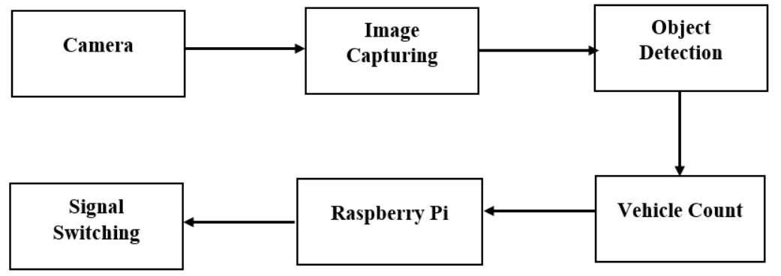
2.1 Proposed System
The image is captured using pi camera and is passed to the model for vehicle detection purpose followed by vehicle counting.
After the object gets detected it forms a rectangular box around the object.
The count obtained from the image obtained from all for side of the road is now passed as input to the raspberry board.
The board calculate the switching time required for signal by comparing the count obtained with the threshold value.
Block diagram of proposed system

Slide 15
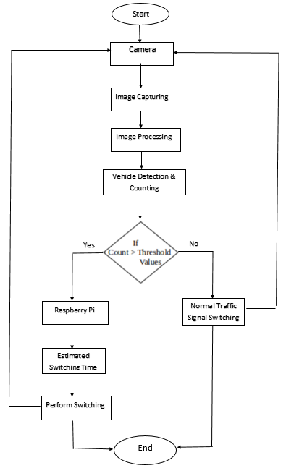
2.2 Flow Of Modules

Slide 16
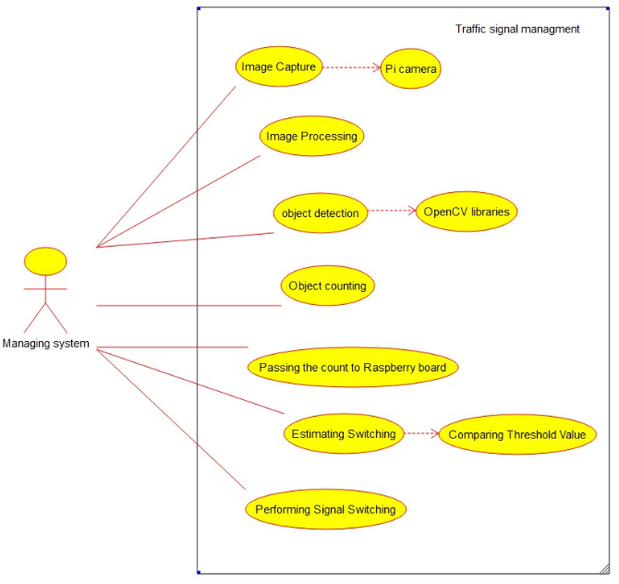
2.3 Description Of Use Case
The managing system is nothing but the
trained model, it has access all over the modules.
The model captures image using pi camera and
provide count to raspberry.
The raspberry board compares the count
with threshold value and computes the
switching time for the signals.

Slide 17
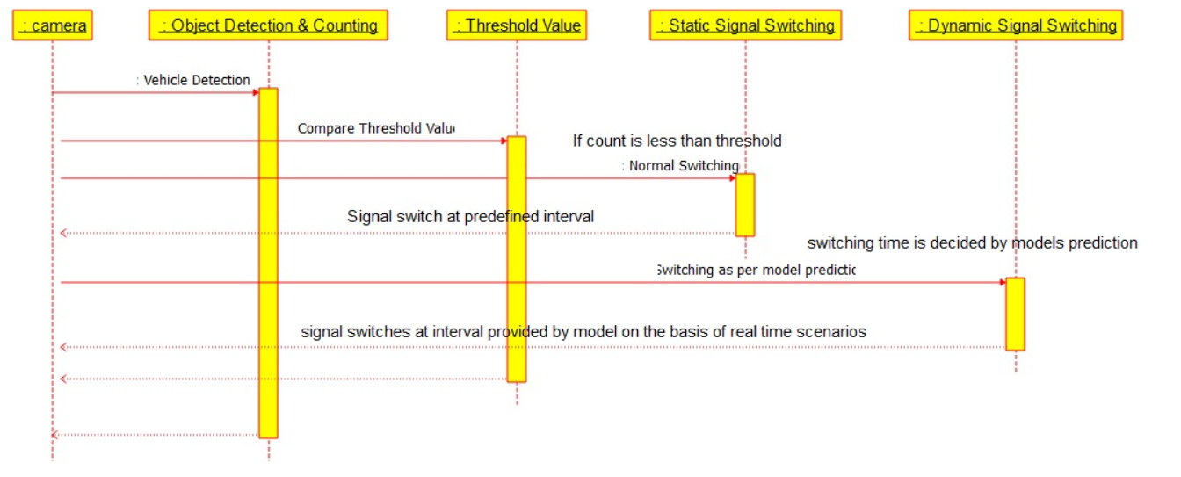
Sequential Diagram

Slide 18
2.6 Module-1
Camera Module:
Camera module which is being used is a pi camera, because of its compatibility and less interfacing with the raspberry board required to make connection.
One single camera module is fitted on the top of stepper motor so that it can rotate 360 degree and capture image of all sides of road.
The motor rotational speed is adjusted in a way that it gives clear images not the blur one and rotates continuously to capture image.
The image captured by the camera is then passed to the model for the further task.
Hence the task of the camera is to capture images constantly at an fixed interval.

Slide 19
Module-2
YOLO Module:
YOLO is one of the most powerful pretrained and is a combined version of R-CNN and SSD, it performs the task of vehicle detection and extract the count of vehicles.
R_CNN uses selective search algorithm and proposes accurate bounding box that definitely contains objects and SSD that helps is speed processing of an image
It divides the image in to mxm grid and calculate confidence and threshold value.
Confidence score is the score that tells us whether object is present or not.
Yolo computes its prediction in terms of precision and recall, precision measures how accurate is your predictions and recall measures how good you find all the positives

Slide 20
Module-3
Raspberry Pi Board:
The output given by the model is provided as input to the board i.e. the count value.
The board compares the count obtained from all four sides of the road, it computes the difference in count and cross check with the threshold value set in the model.
If difference is less than threshold then normal switching at predefined regular interval is performed else the board has to compute different switching time for different signals.
The switching time decided by the board is then passed to the led and signal switching is done and this process is executed in continuous loop manner.

Slide 21
2.7 References
[1] Indrabayu , Rizki Yusliana Bakti , Intan Sari Areni , A. Ais Prayogi “Vehicle Detection and Tracking using Gaussian Mixture Model and Kalman Filter” , 2016 International Conference on Computational In telligence and Cybernetics Makassar , Indonesia , 22-24 November 2016
[2] Li Xun , Nan Kaikai , Liu Yao , Zuo Tao “A Real-Time Traffic De tection Method Based on Improved Kalman Filter”, 2018 3rd Interna tional Conference on Robotics and Automation Engineering (ICRAE)
Guangzhou , China , 17-19 November 2018
[3] Safoora Maqbool , Mehwish Khan , Jawaria -Tahir , Abdul Jalil , Ahmad Ali , Javed Ahmad Vehicle Detection, Tracking and Counting” 2018 IEEE 3rd International Conference on Signal and Image Pro cessing (ICSIP) Shenzhen , China , 13-15 July 2018
[4] R. Krishnamoorthy , Sethu Manickam “Automated Traffic Moni toring Using Image Vision” ,The 2nd International Conference on In ventive Communication and Computational Technologies (ICICCT 2018) Coimbatore , India , 20-21 April 2018

Slide 22
References
[5] Jess Tyron G. Nodado , Hans Christian P. Morales , Ma AngelicP. Abugan , Jerick L. Olisea , Angelo C. Aralar , Pocholo James M. Loresco “Intelligent Traffic Light System Using Computer Vision with Android Monitoring and Control” , Proceedings of TENCON 2018 - 2018 IEEE Region 10 Conference Jeju, Korea(south) , 28-31 October 2018
[6] Sayan Mondal, Alan Yessenbayev, Jahya Burke, Nihar Wahal, “A Survey of Information Acquisition in Neural Object Detection Systems”, 32nd Conference on Neural Information Processing Systems (NeurIPS 2018), Montréal, Canada.
[7] Joseph Redmon, “YOLOv3: An Incremental Improvement” Ali Farhadi University of Washington

Slide 23
3.Planning

Slide 24
Planning
Switching using raspberry pi after comparing with the threshold value.
Deciding the maximum and minimum timing that can be provided to led to remain green in real time signal switching based scenario.
To check whether all sides of signals turns green for once in every cycle.
To store the logs of switching for analysis purpose and also duly verify whether signal switching which is being practiced is accurate or not.

Slide 25
Thank You

